Slide 1
Operating System Fundamentals
Computer Engineering
Notes:
Introduction to the presentation on Operating System Fundamentals.

Slide 2

Introduction to Operating Systems
Operating systems manage computer hardware and software resources efficiently and effectively always
OS acts as an intermediary between computer hardware and user level applications software
Primary goal of an operating system is to provide a platform for applications to run
Operating systems provide a layer of abstraction between hardware and user applications software
OS manages memory allocation and deallocation for running applications and services efficiently
Security and authentication mechanisms are implemented in operating systems to prevent unauthorized access
Operating systems provide a user interface for interacting with computer hardware and software resources
File system management is a critical function of operating systems for data storage and retrieval
Process management and scheduling are essential operating system functions for efficient resource utilization
Notes:
Present Introduction to Operating Systems in the context of Operating System Fundamentals.

Slide 3
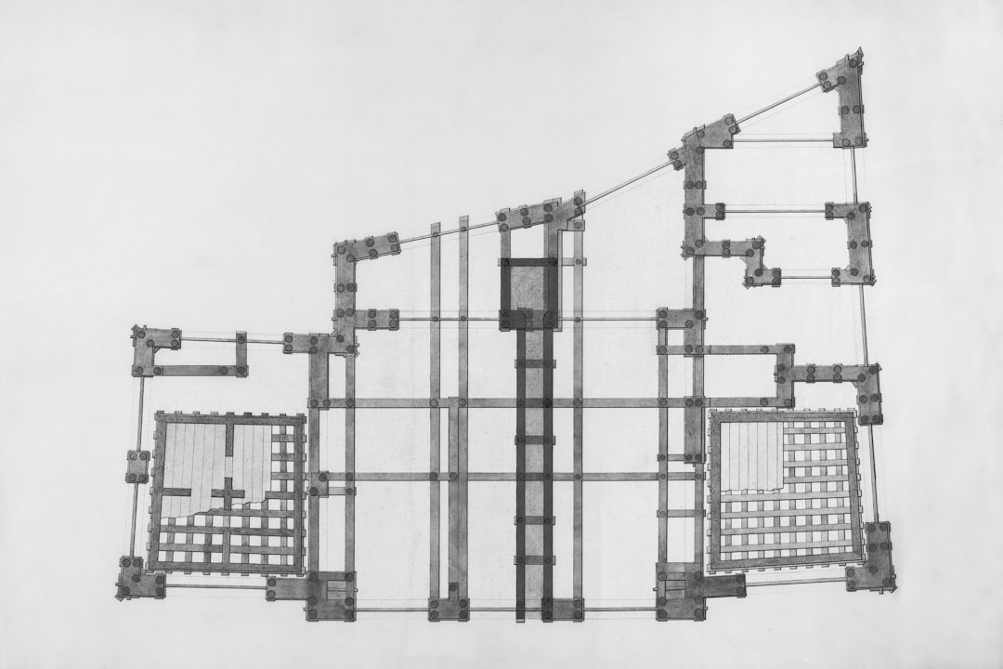
Process Management Concepts
A process is a program in execution with its own memory space.
Process scheduling determines which process runs at a given time.
Notes:
Present Process Management Concepts in the context of Operating System Fundamentals.

Slide 4
Memory Management Techniques
Paging technique divides memory into fixed-size blocks for efficient allocation and deallocation
Segmentation method organizes memory into variable-size blocks for better memory utilization
Virtual memory combines physical and secondary storage for increased memory capacity
Memory protection prevents unauthorized access to memory regions using access control
Swapping technique involves exchanging pages or processes between main and secondary memory
Cache memory stores frequently accessed data for faster retrieval and execution
Memory allocation algorithms manage free memory blocks for optimal allocation and minimization
Dynamic memory allocation assigns memory to programs at runtime for efficient usage
Memory fragmentation occurs when free memory is broken into small unusable blocks
Memory compaction rearranges memory to eliminate fragmentation and improve allocation
Notes:
Present Memory Management Techniques in the context of Operating System Fundamentals.

